Slide 1
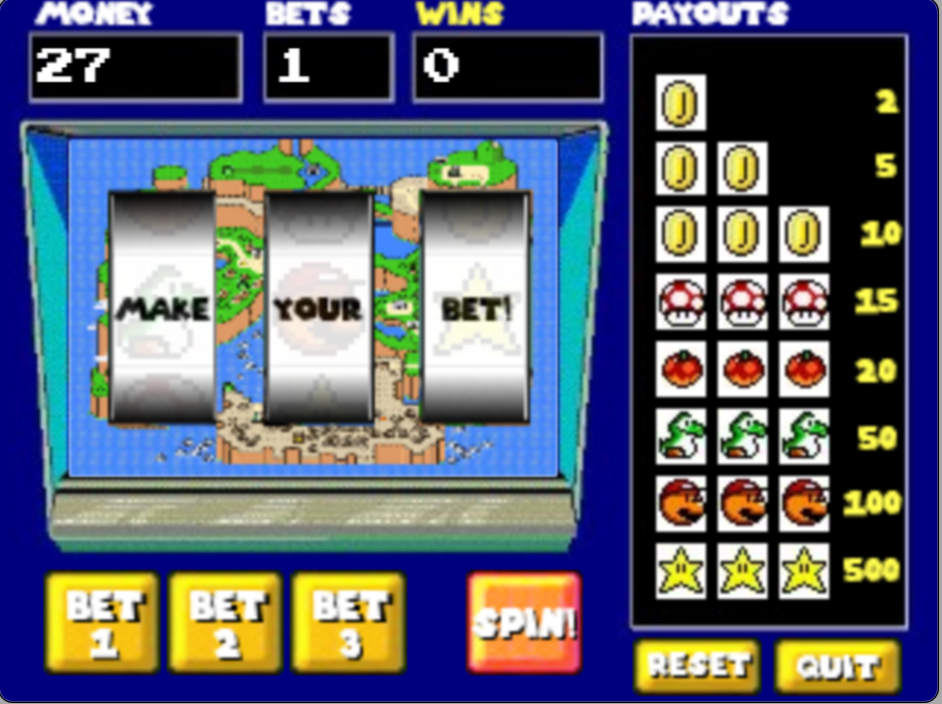
Remaining player money
# of bets waged
# of player wins
Reels
Betline
“Payouts” reference table
Quit (displays “thank you” message)
Betting buttons
“Spin” button
Reset game

